Slide 1
Programming in Python
WELCOME
Lecturer No: | 01 | Week No: | 1 | Semester: | Fall 2026/27
Lecturer: | Md Kamrul Islam

Slide 2
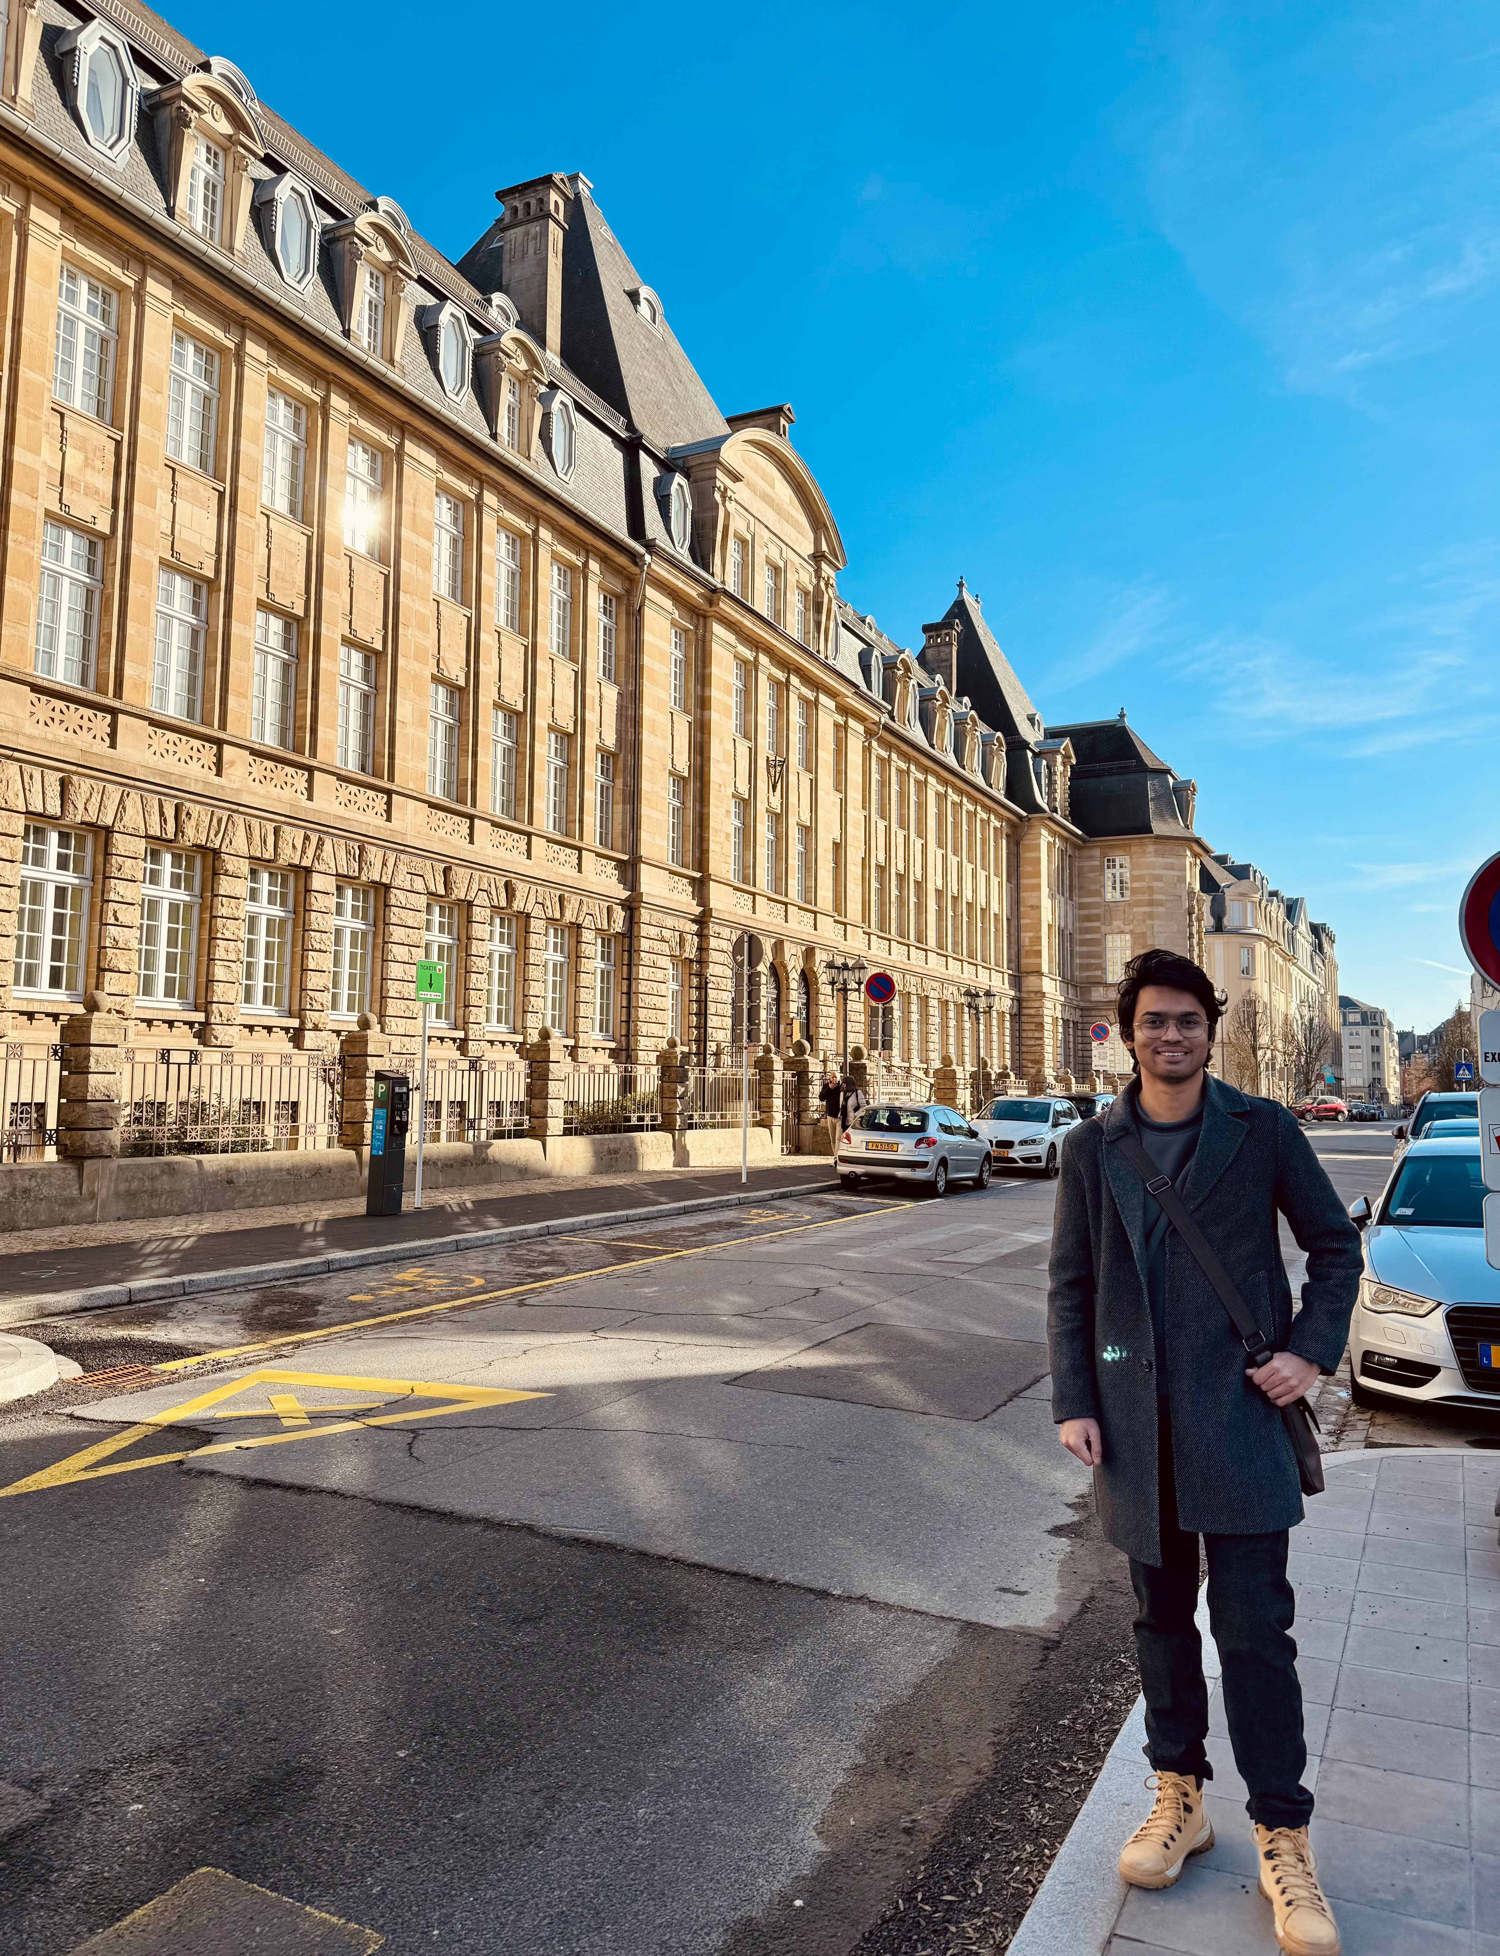
Course Instructor
Lecturer | AI Researcher
Education Background:
Erasmus Mundus Joint Master’s in Big Data Management & Analytics ---
  Université Libre de Bruxelles
  Universitat Politècnica de Catalunya (BarcelonaTech)
  CentraleSupélec, Université Paris-Saclay
B.Eng. in Software Engineering, Sichuan University
Research Interests:
• Foundation Models (LLMs, MLLMs, Vison Transformer)
• RAG • Deep Learning • Multimodal AI • Frugal AI
Email: mdkamrul.islam@aiub.edu
Room No: 9210K

Slide 3
Class Rules
Mandatory Class Attendance
  Every class is part of your learning journey
Join in discussions
  This is how we practice thinking critically together
Be on time, and deadlines
  Show respect for your classmates and teacher
Anyone may ask questions at any time
  Don’t judge others’ questions

Slide 4
Why Come to Class?
Learn by doing
Write, run, and debug code—not just watch lectures.
Develop problem-solving skills
Learn how to approach and break down programming problems.
Learn through interaction
Ask questions, discuss solutions, and explore different approaches.
Get immediate feedback
Identify mistakes and improve before assessments and projects.
Build practical skills
Apply concepts through hands-on exercises, labs, and projects.
Attend. Practice. Ask. Improve. Build.

Slide 5
Course Information
This course focuses on learning advance programming and problem- solving techniques using Python.
Course: CSC 4162 / BSE 4112 — Programming in Python
Credits: 3
Weekly Contact: 2 hrs Theory + 2 hrs 20 min Lab
Prerequisite: CSC 3215 / BSE 1201 — Web Technologies
Course Type: Elective for CSE | Core for DS, CNCS

Slide 6
Course Outline
This course focuses on learning advance programming and problem- solving techniques using Python.
Stage | What you’ll learn
1. Python Foundations | Variables, data types, control flow, functions, object-oriented programming
2. Working with Data | Files, exceptions, structured data
3. Numerical Computing | NumPy
4. Data Analysis | Pandas
5. Visualization | Matplotlib
6. Machine Learning | Scikit-learn
7. Data + Databases | Connecting Python with databases

Slide 7
Learning outcomes
Apply Python programming fundamentals to solve computational problems.
Design and implement algorithms using appropriate programming techniques and Python best practices.
Work with data using Python through NumPy, Pandas, and other relevant libraries.
Develop data visualizations to explore, analyze, and communicate data effectively.
Apply machine learning techniques using Python to address practical problems.
Develop Python-based solutions that integrate programming, data analysis, and problem-solving skills.
Analyze and evaluate solutions considering relevant societal, environmental, health, and safety considerations.

Slide 8
Evaluation
Mid Term | Attendance | 10
 | Laboratory Performance/Assignment | 10
 | Quizzes | 30
 | Midterm Project/Report/VIVA | 50
 | Mid Term Total | 100 | 40%
Final Term | Attendance | 10
 | Laboratory Performance/Assignment | 10
 | Quizzes | 30
 | Final Term Project/Report/VIVA | 50
 | Final Term Total | 100 | 60%
Grand Total |  |  | 100%
No make-up for missing evaluation without valid reason.

Slide 9
Before contacting me:
    Check the course materials.
    Try the problem yourself.
For consultation:
    Contact me via Email/Teams
    Use the designated consultation channel/time
    For project questions, come with your current progress

Slide 10
Book/Reference
https://www.w3schools.com/python/
https://leetcode.com/problemset/
Python Cookbook. O’Reilly Media.
Phuong Vothihong, Martin Czygan, Ivan Idris, Magnus Vilhelm Persson, Luiz Felipe Martins. Python: End to End Data Analysis. Packt Publishing

Slide 11
Questions?
Thank you!

